Slide 1
Android studio basics
Mobile applications development
J m githeko
March 2016

Slide 2
agenda
This lesson is aimed at covering the following knowledge and skills:
To be able to:
Outline the requirements for installing a functional Android development environment based on Android Studio
Describe the architecture of the Android OS
Explain how the Model-View-Controller app architecture is implemented in Android
Describe the elements of an Android application
Identify key elements of the Android Studio IDE interface and explain their functions
Create a simple, functioning, Android app and install it in an Android device

Slide 3
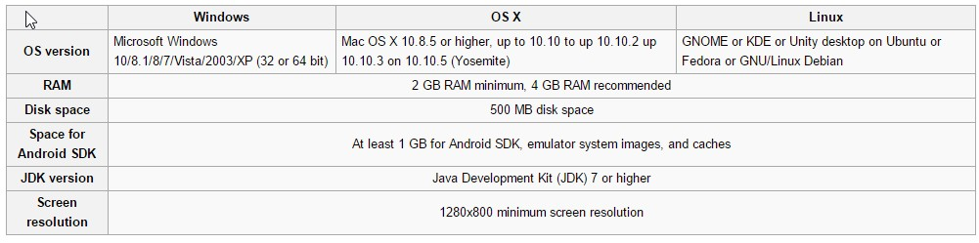
Requirements for installing android studio

Slide 4
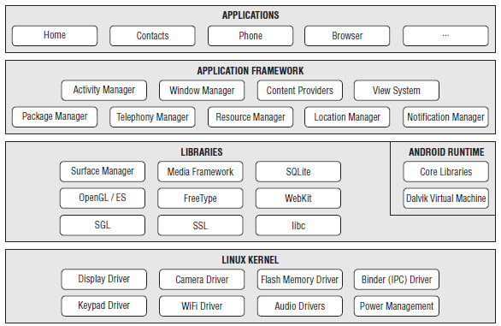
Android os architecture [older model]
Applications
Application Framework
Libraries
Runtime (virtual machine)
Linux Kernel

Slide 5
Linux kernel
Contains all the low-level device drivers for the various hardware components of an Android device.

Slide 6
Libraries
Contain all the code that provides the main features of an Android OS.
Example:
SQLite library provides database management functions.
The WebKit library provides web browsing functions.
OpenGL provide graphics functions

Slide 7
Android runtime
In the same layer as the libraries.
Provides a set of core libraries that enable developers to write Android apps using the Java programming language.
Dalvik virtual machine (now replaced by ART) :
Enables every Android application to run in its own process
Each app runs in its own instance of the DVM hence provides for application sandboxing, which is the cornerstone of the Android security model
Android apps are compiled into the DVM executables
DVM is a specialized virtual machine designed specifically for Android and optimized for battery-powered mobile devices with limited memory and CPU.

Slide 8
Application framework
Exposes the various capabilities of the Android OS to application developers so that they can make use of them in their applications.

Slide 9
Model-View-Controller

Slide 10
model
Is the core of your application
Examples:
The database of music on your device and the code for playing the music.
Your list of contacts and the code that places phone calls or sends SMSs to them.
One Model might be used by several different applications. Example, both an MP3 player and a file converter needs a Model to handle MP3 files
The Model is all about the data

Slide 11
View
Part of the application responsible for generating items to be displayed, sending audio to the speakers, generating tactile (touch) feedback, and so on.
Android has a View System framework for this purpose

Slide 12
Controller
The Controller is the portion of an application that responds to external actions .
Examples of actions (events): A keystroke, a screen tap, an incoming call, sensor output.
It is implemented as an event queue and each external action is represented as a unique event in the FIFO queue.
Each event is handled (dispatched) then removed from the queue.
Example: In an MP3 player application when the user taps a Play/Pause button on the screen and the event is dispatched to that button’s object, the handler method might update the Model to resume playing some previously selected tune.

Slide 13
M-V-C Operation
Action (Event) happens
Controller captures Event and places it in Event Queue
Event is dispatched to a handler method and dequeued
Handler responds to event by notifying the Model about change in state.
Model takes the appropriate action.
Nearly any change in Model state will require a corresponding change in the View

Slide 15
Architecture of an android app

Slide 16
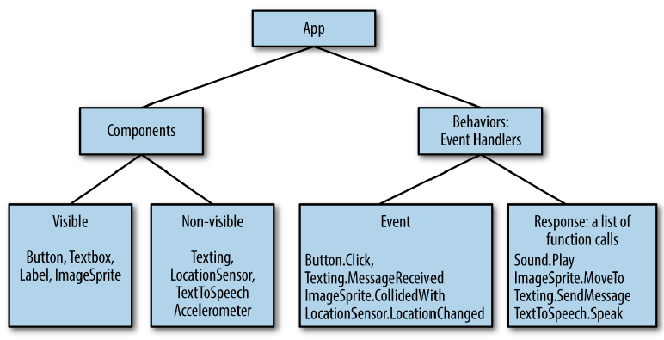
Internal structure of an app

Slide 17
Components vs behaviours
After looking at the M-V-C model we can appreciate that:
Components correspond to the View
Behaviours correspond to the Controller
From a programming perspective:
Behaviours are implemented as methods, specifically, event-handlers
Event detectors are called Listeners in Java parlance
Visible components such as buttons and textboxes make up the UI
Invisible components such as Accelerometer and Gyroscope are the technology
All components have properties that can be read and sometimes changed programmatically (through code)

Slide 18
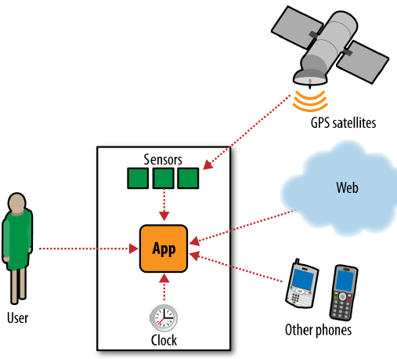
Apps as event-response machines
Apps detect and react to events in a non-linear manner.
Events can be initiated by the user, by the app itself (sensors, code) or by external entities such as an incoming call or message

Slide 19
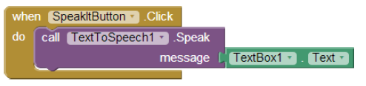
App inventor event model
The brown block is the event identifier [button click]
The purple block is the event handler [speak]
The green block is the handler input/data [text input]
An equivalent Javascript event handler would be: OnClick=“Speak(‘Text..’)”

Slide 20
Android Studio IDE interface

Slide 21
Creating a Simple android app

